Slide 1


An Intelligent Approach to Flight Delay Prediction & Analysis
Guided By:
Mr. Tushar Kute
Mrs. Trupti Joshi
Submitted By:
Chaitanya Larokar (220943025010)
Vaibhav Gavli (220943025052)
Pushpak Paunikar (220943025029)
Akash Kunjir (220943025016)

Slide 2

Introduction
In the last few years, air travel has become a common, easy and affordable mode of transport.
Over 100,000 commercial flights operate on a daily basis, around 200,000 flights arrive delayed each year which causes huge losses for airlines as well as their customers.
Flights can be delayed due to various reasons, some of them being, extreme weather conditions, heavy air traffic, due to air carrier, etc.
Predictive machine learning model of a classifier & regression using flight delay information.

Slide 3
Objective of Project
The objective is to examine the impact of various factors on the arrival delay for domestic flights in the United States.
It uses a machine learning model to classify and predict the arrival delays of various flights in different airports & predict the delay time of flight using regression, during the years 2019 - 2021.
The machine learning classification & regression algorithms are then evaluated with standard metrics and hence compared.

Slide 4




Overview of Tools Used
Python
Spark
Machine Learning
Tableau

Slide 5
Project Summary
Understanding of business need
Collection of data
Understanding of flight data
Preparing data for modeling
Creating predictive models

Slide 6

Dataset
Data source :
Bureau of Transportation Statistic (BTS) (https://www.bts.gov/)
Data content:
Flight delay features of different airports for year 2019 and 2021
Data understanding :
Available variables
Relationships
Data Preparation :
Missing values
Redundant variables

Slide 7

Data Cleaning Operation
Define the problem
Collect the data
Check for duplicates
Handle missing vales
Standardize the data
Validate the data

Slide 8
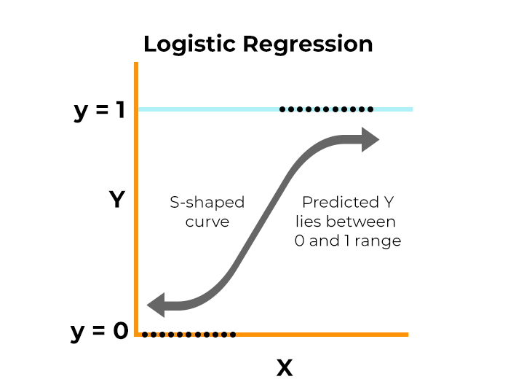


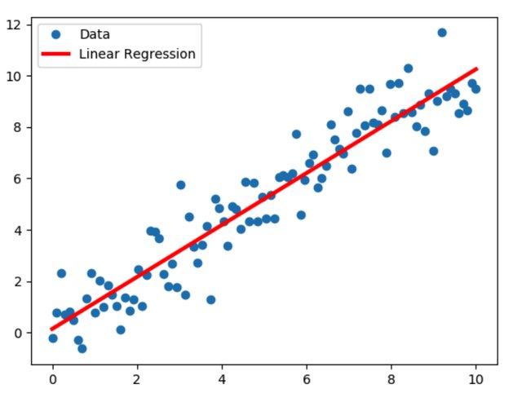
Models
Classification:
Logistic Regression
Decision Tree Classifier
Random Forest Classifier
Regression:
Linear Regression
Decision Tree Regressor
Random Forest Regressor

Slide 9
Classification
Algorithm | Train Accuracy | Test Accuracy
Logistic Regression | 1.0 | 1.0
Decision Tree Classifier | 1.0 | 1.0
Random Forest Classifier | 1.0 | 1.0
Regression
Algorithm | Train R Squared | Test R Squared | MSE | MAE
Linear Regression | 0.99 | 0.99 | 1.08e-07 | 2.39e-06
Decision Tree Regressor | 0.92 | 0.92 | 0.07096 | 0.07411
Random Forest Regressor | 0.93 | 0.90 | 0.083091 | 0.04552

Slide 10
Analysis
Analysis using Tableau

Slide 11
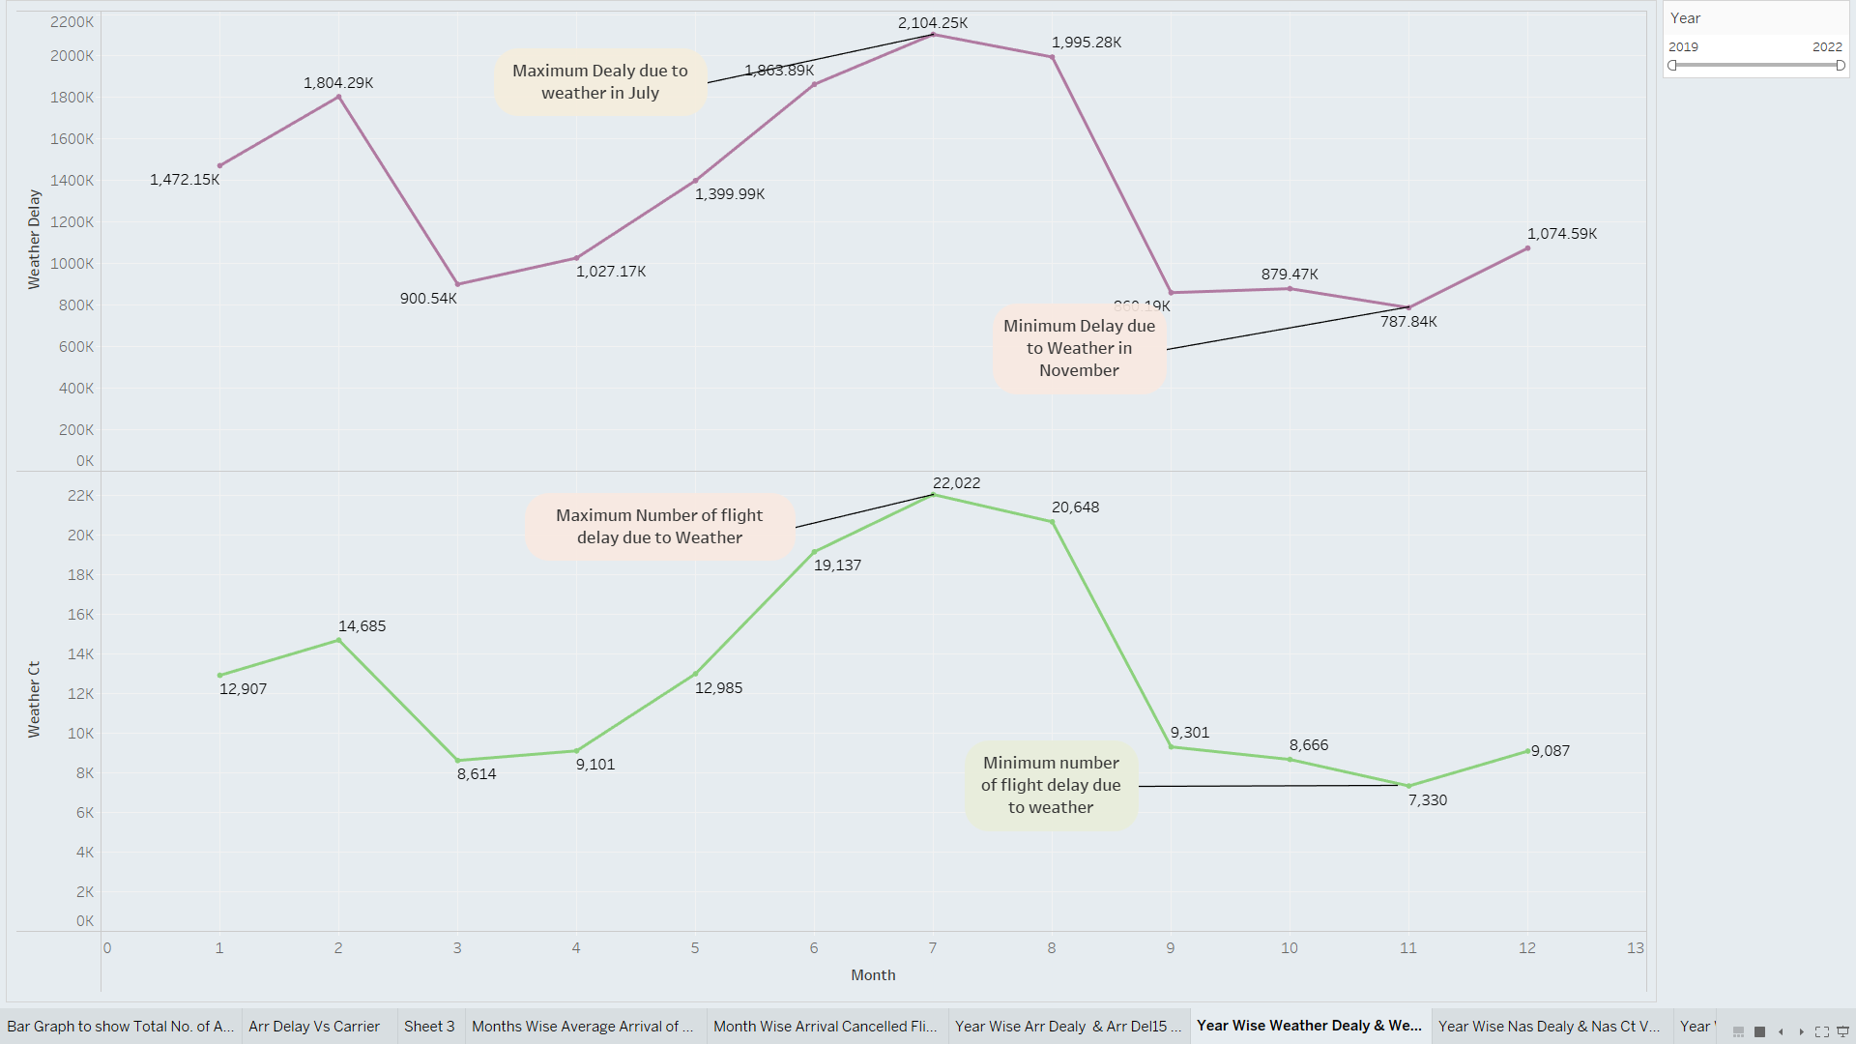
Preliminary Findings - Year Wise Weather Delay & Weather Ct Vs Month
It is observed from this chart that maximum delay due to weather is in July and minimum delay is in November.

Slide 12
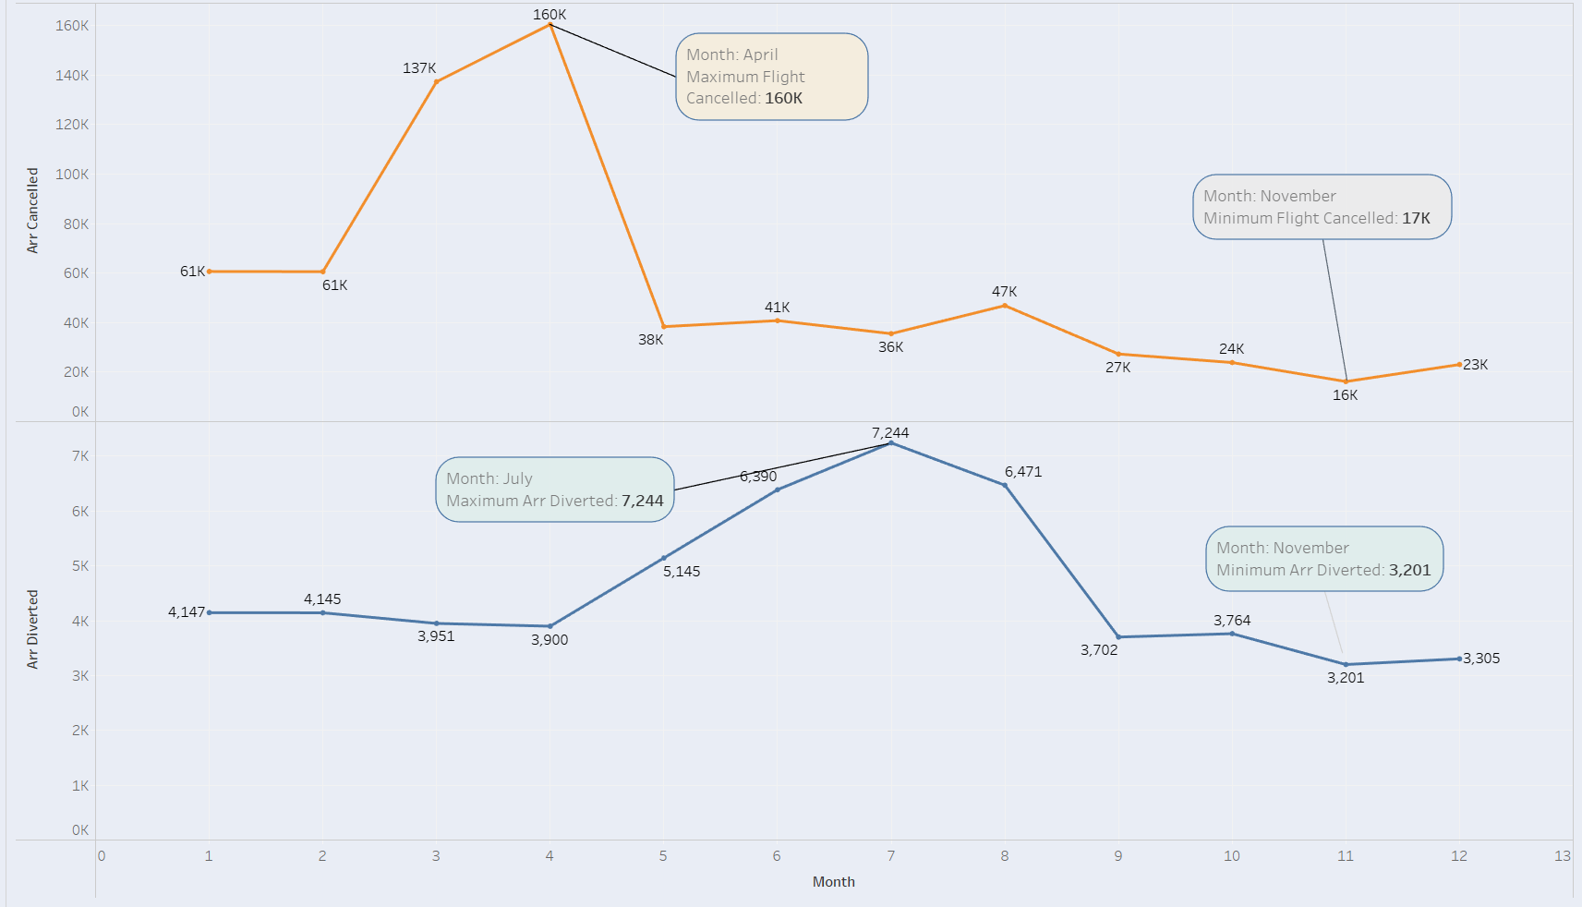
Month Wise Cancelled Flight
From the above chart it is observed that maximum number of cancelled flight is in April and minimum number of cancelled flight is in November.

Slide 13
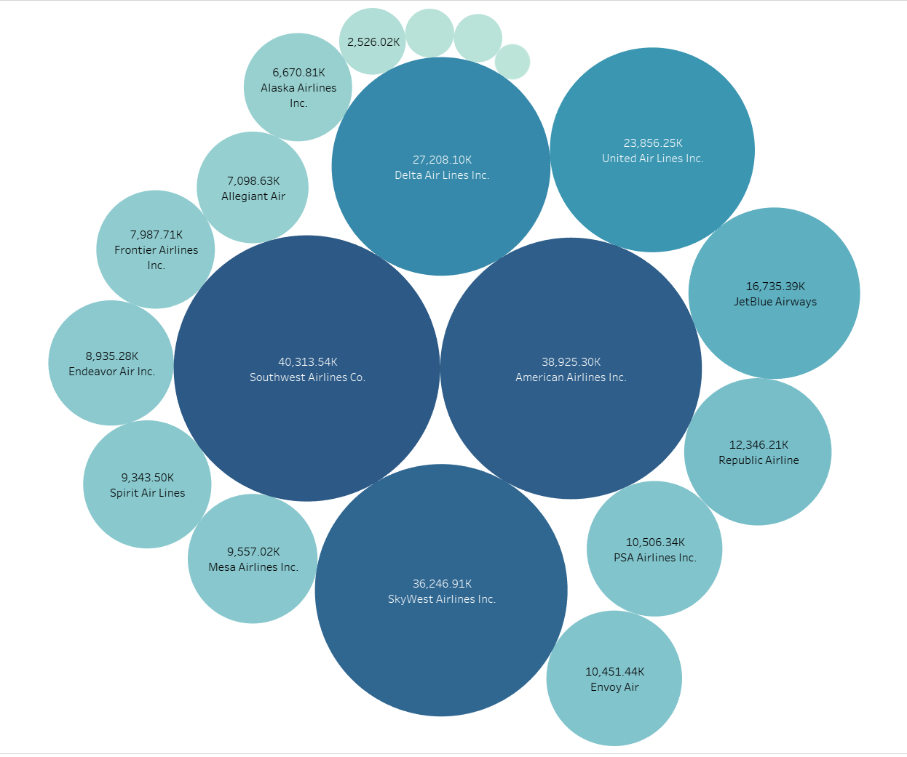
Carrier Performance
Bubble chart shows the air carrier wise performance.
Arr delay (delayed flight in minutes) with respect to Air carrier
From above chart it is observed that ExpressJet Airline has minimum delay hence it has good performance.
On other hand Southwest Airlines has maximum delay hence it has poor performance.

Slide 14
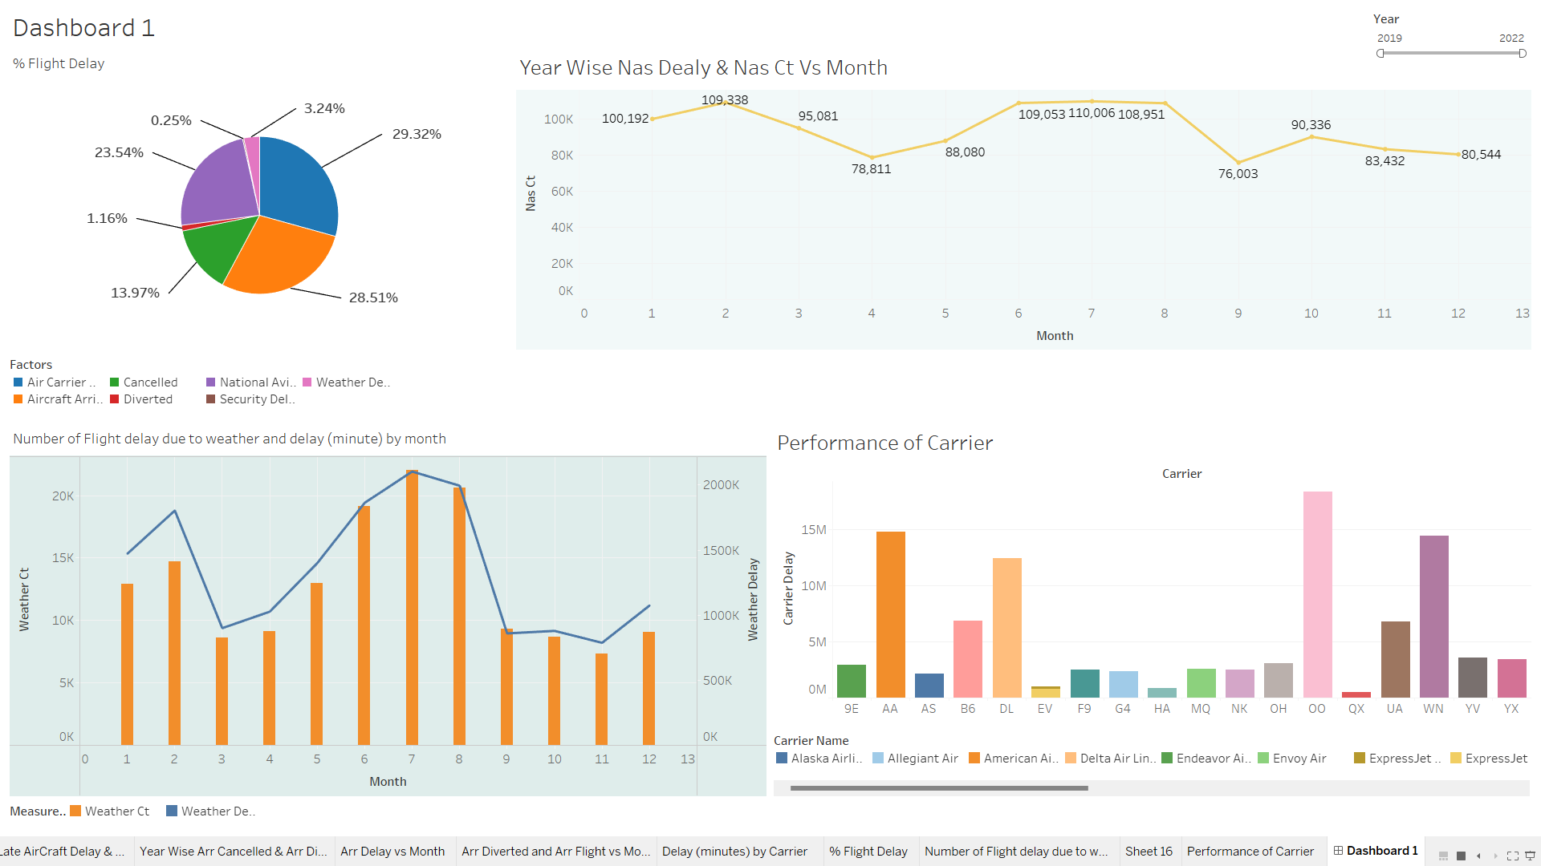

Slide 15
Analysis
Among all the factors affecting flight delay, carrier delay, delay due to National Aviation System, Aircraft Arriving late are the major factors.
In month of February maximum number of flights were delayed due to heavy air traffic which is controlled by NAS.
The numbers of flights delayed and the total time of delay due to Weather is maximum from June to august.
SkyWest Airline has maximum numbers of flights delay due to Air Carrier (performance of crew members).

Slide 16
Conclusion
Overall, the flight delay prediction and analysis project has provided valuable insights into the potential of data analytics and machine learning in the aviation industry. By developing accurate and efficient prediction models, this technology has the potential to transform the way airlines and airport authorities manage air travel disruptions, thereby improving the overall customer experience
Hence two stage, classification and regression, machine learning engine was designed and built to classify whether if a flight will arrive late or on time and predict the number of minutes by which a flight arrive late.

Slide 17
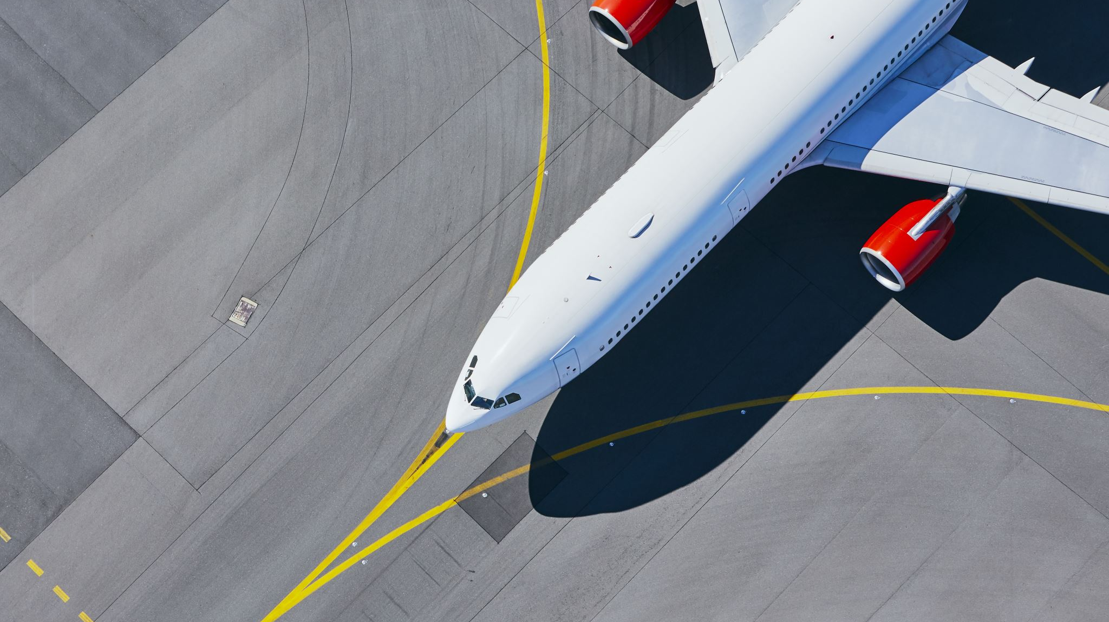
Thank You

